Slide 1
UNIT-3
Lecture 3

Slide 2
What is Bivariate Analysis?
Bivariate Analysis refers to the statistical analysis of two variables to determine the relationship between them.
Purpose:
Understand how one variable influences another
Identify correlation or association
Detect patterns and trends
Example relationships:
Income vs Spending
Study hours vs Marks
Advertising budget vs Sales

Slide 3
Types of Bivariate Relationships:
Variable Type | Example | Visualization
Numerical vs Numerical | Age vs Salary | Scatter Plot
Categorical vs Numerical | Gender vs Salary | Box Plot
Categorical vs Categorical | Gender vs Purchase | Bar Plot / Cross Tab

Slide 4
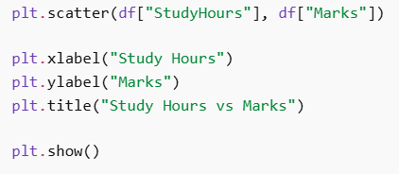
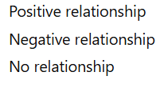
Scatter Plot (Numerical vs Numerical):
Scatter plot shows relationship between two numerical variables.
Example: Study Hours vs Marks
You will information about:

Slide 5
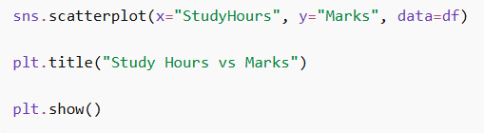
Scatter Plot Using Seaborn:
Advantages: 1. Better visualization 2. Additional statistical features

Slide 6
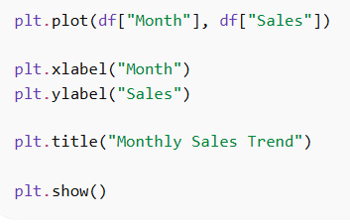
Line Plot (Trend Analysis):
Line plot is useful for showing trends between two variables.
Example: Sales over time

Slide 7
Violin Plot (Categorical vs Numerical):
A Violin Plot is used to visualize the distribution of a numerical variable across different categories.
It combines features of:
Box Plot
Kernel Density Estimation (KDE)
The violin shape represents the probability density of the data.
Violin plots help to:
Compare distributions across categories
Identify multimodal distributions
Observe spread and density of data

Slide 8
Structure of a Violin Plot:
A violin plot displays:
Median of the data
Interquartile range
Density distribution of the variable
Interpretation:
Wider section → Higher data density
Narrow section → Lower data density

Slide 9
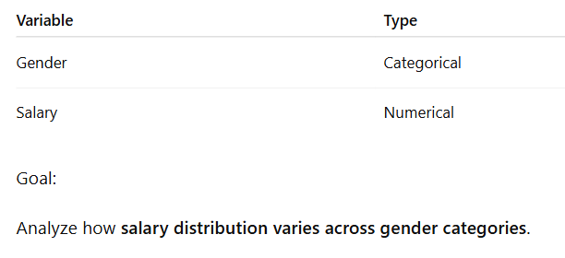

Slide 10
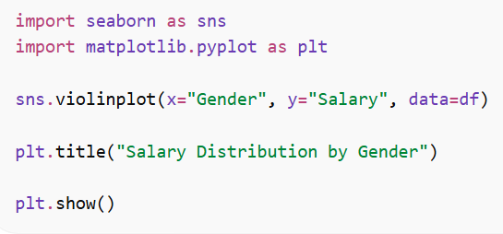
From the violin plot we can observe:
Distribution of salary for each gender
Median salary
Density of values
Spread of the data
Possible outliers
Example insights:
If one violin is wider → more observations in that range
If distributions differ → categories have different data patterns

Slide 11
Violin Plot vs Box Plot:
Feature | Box Plot | Violin Plot
Shows median | Yes | Yes
Shows quartiles | Yes | Yes
Shows density distribution | No | Yes
Data distribution view | Limited | Detailed

Slide 12
Advantages of Violin Plot:
Shows full data distribution
Combines box plot and density plot
Useful for comparing multiple categories
Reveals multimodal distributions

Slide 13
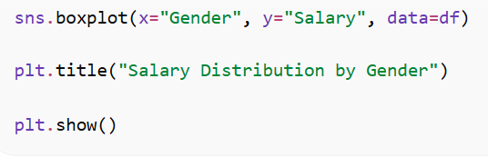
Box Plot (Categorical vs Numerical):
Box plot compares distribution of numerical values across categories.
Example: Salary by Gender

Slide 14
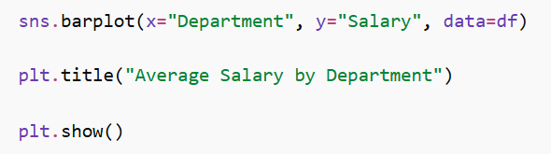
Bar Plot (Categorical vs Numerical):
Bar plot shows average values across categories.
Example: Average salary by department

Slide 15
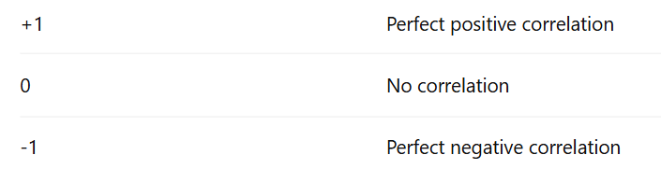
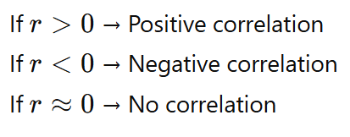


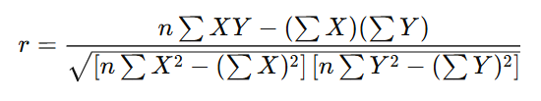
Correlation Analysis:
Correlation measures strength of relationship between variables.
Range of correlation coefficient:

Slide 16
Find the correlation between study hours and marks.
Hours (X) | Marks (Y)
1 | 35
2 | 40
3 | 50
4 | 55
5 | 65

Slide 17
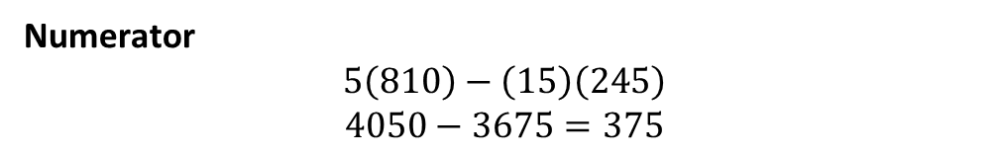

X | Y | X² | Y² | XY
1 | 35 | 1 | 1225 | 35
2 | 40 | 4 | 1600 | 80
3 | 50 | 9 | 2500 | 150
4 | 55 | 16 | 3025 | 220
5 | 65 | 25 | 4225 | 325
∑X=15
$$\sum{Y}=245$$
$$\sum{X^{2}}=55$$
$$\sum{Y^{2}}=12575$$
$$\sum{X}Y=810$$
$$n=5$$
Numerator
$$5\left(810\right)−\left(15\right)\left(245\right)$$
$$4050−3675=375$$

Slide 18
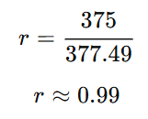
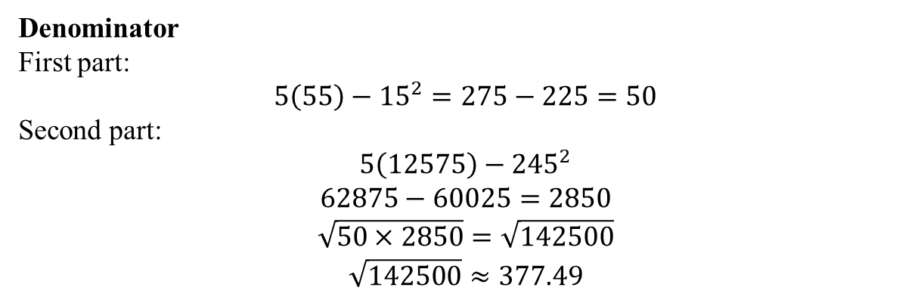
Denominator
First part:
$$5\left(55\right)−{15}^{2}=275−225=50$$
Second part:
$$5\left(12575\right)−{245}^{2}$$
$$62875−60025=2850$$
$$\sqrt{50×2850}=\sqrt{142500}$$
$$\sqrt{142500}≈377.49$$

Slide 19
Find Correlation:
X | Y
1 | 10
2 | 8
3 | 6
4 | 5
5 | 3

Slide 20
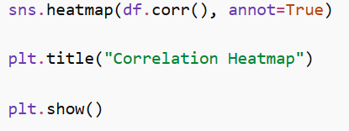
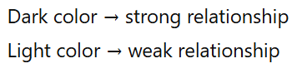
Heatmap for Correlation:
Heatmap visualizes correlation between multiple variables.

Slide 21
Advantages of Bivariate Analysis:
Helps understand relationships between variables
Identifies correlations
Detects patterns and trends
Useful for feature selection
Supports predictive modeling

Slide 22
Applications of Bivariate Analysis:
Bivariate analysis is used in:
Business analytics
Marketing analysis
Financial forecasting
Healthcare analytics
Machine learning feature selection

